Slide 1
APTA Guide to Physical Therapist Practice
Educator Module
2023

Slide 2
Educator Module
The goal of these slides is to assist and enhance student learning using the Guide to Physical Therapy Practice. It touches on the main points within the Guide and includes activities for students to work on to increase their understanding of physical therapy.

Slide 3
Chapter 1: Introduction to the APTA Guide to Physical Therapist Practice

Slide 4

Who Are Physical Therapists?
Physical therapists are health professionals who diagnose and manage movement dysfunction as it relates to the restoration, maintenance, and promotion of optimal physical function and the health and well-being of individuals, families, and communities.
Physical therapists possess a distinct body of knowledge that provides a unique perspective on purposeful, precise, and efficient movement across the life span.

Slide 5

What Do Physical Therapists Do?
Based on the person’s diagnosis, prognosis, and goals, physical therapists design and implement a customized and integrated plan of care in collaboration with the individual to achieve the individual’s goal-directed outcomes.
Physical therapists work towards maximizing an individual’s ability to engage with and respond to their environment, emphasizing movement-related interventions to optimize functional capabilities and performance.

Slide 6
Activity
In your own terms, describe physical therapist practice.

Slide 7
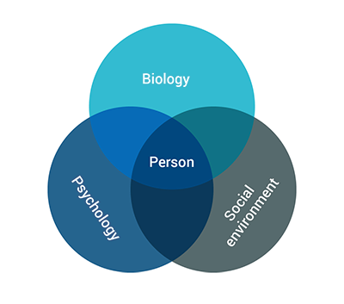
Biopsychosocial Model
In this model, a person’s health status is determined by the interplay of the biological, psychological, and social domains.
Notes:
The World Health Organization defines health as a “state of complete physical, mental, and social well-being and not merely the absence of disease or infirmity.”
Physical therapist practice incorporates the concepts and terminology of the WHO’s International Classification of Functioning, Disability and Health, more commonly known as the ICF. The ICF provides an important framework for physical therapist practice: to prevent, minimize, or eliminate impairments of body functions and structures, activity limitations, and participation restrictions by optimizing movement.

Slide 8
Social Determinants of Health
SDOH are the measure of all the exposures of an individual in a lifetime and how those exposures relate to health.
SDOH influence the environmental context of movement and health.
Social risk factors are the adverse social conditions that may lead to poor health.

Slide 9

Social Determinants of Health
Social determinants of health include items such as economic stability, age, gender, social status, access to health services, quality education, healthy environments, social and community context and support, and healthy environments.
Notes:
Physical therapists recognize that health is influenced by many factors that extend beyond the clinic or the direct application of health services. Health — whether at an individual or a population level — extends into the home, workplace, school, neighborhood, and community.

Slide 10
Activity
Find a photo that demonstrates a social determinant of health. Write a caption that describes a current goal to address this.

Slide 11

Physical Therapist Practice Core Concepts
Commitment to professional practice includes:
Evidence-based practice includes:
Evidence-based practice
Quality assessment and outcomes
Professional values
Notes:
Evidence-based practice, or EBP, is the integration of best-available research evidence, the clinician’s knowledge and skills (experience), and the patient’s values and circumstances.
Quality in physical therapist practice: It is important that physical therapists measure the quality and impact of their services. Physical therapists use quality measures to help record or quantify health service delivery processes, outcomes, and perceptions and to assess the effectiveness and efficiency of organizational structures and/or health systems.
Physical therapists and physical therapist assistants demonstrate professional values in all aspects of their practice.

Slide 12
Quality Measurement and Outcomes
It is important that physical therapists measure the quality and impact of their services. Physical therapists use quality measures to help record or quantify health service delivery processes, outcomes, and perceptions, and to assess the effectiveness and efficiency of organizational structures and/or health systems.

Slide 13
Core Values
APTA Core Values
Accountability
Altruism
Collaboration
Compassion and Caring
Duty
Excellence
Inclusion
Integrity
Social Responsibility
Notes:
Core values guide the behavior of PTs and PTAs to provide the highest quality of physical therapist services. The core values retain the physical therapist as the person ultimately responsible for providing safe, accessible, cost‐effective, and evidence‐based services; and the physical therapist assistant as the only individual who assists the physical therapist in practice, working under the direction and supervision of the physical therapist.
Grounded in these core values, physical therapists and physical therapist assistants work collaboratively with individuals at all stages of life, their families and communities, and professionals in other health disciplines to achieve shared goals. PTs and PTAs honor the individual as the focus of all service delivery and respect the contributions made by other health providers. In addition, physical therapists accept responsibility and accountability for exercising professional judgment within their scope of practice.
Physical therapists ensure that their clinical judgment and the needs of the individual have primacy over organizational, payment, or other pressures that might arise in conflict.
The core values are defined individually on the following slides.

Slide 14
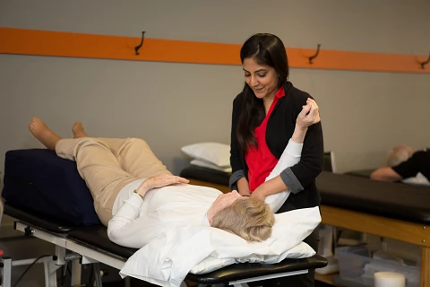
Core Values: Accountability
Active acceptance of the responsibility for the diverse roles, obligations, and actions of the physical therapist and physical therapist assistant including self‐regulation and other behaviors that positively influence patient and client outcomes, the profession, and the health needs of society.

Slide 15

Core Values: Altruism
The primary regard for or devotion to the interest of patients and clients, thus assuming the responsibility of placing the needs of patients and clients ahead of the physical therapist’s or physical therapist assistant’s self‐interest.

Slide 16

Core Values: Collaboration
Working together with patients and clients, families, communities, and professionals in health and other fields to achieve shared goals. Collaboration within the physical therapist‐physical therapist assistant team is working together, within each partner’s respective role, to achieve optimal physical therapist services and outcomes for patients and clients.

Slide 17
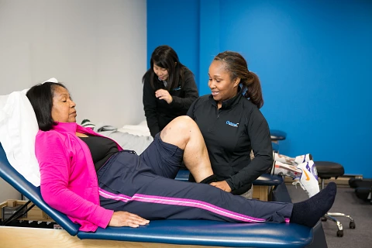
Core Values: Compassion and Caring
Compassion is the desire to identify with or sense something of another’s experience, a precursor of caring. Caring is the concern, empathy, and consideration for the needs and values of others.

Slide 18

Core Values: Duty
The commitment to meeting one’s obligations to provide effective physical therapist services to patients and clients, to serve the profession, and to positively influence the health of society.

Slide 19

Core Values: Excellence
The provision of physical therapist services occurs when the physical therapist and physical therapist assistant consistently use current knowledge and skills while understanding personal limits, integrate the patient or client perspective, embrace advancement, and challenge mediocrity.

Slide 20

Core Values: Inclusion
Occurs when the physical therapist and physical therapist assistant create a welcoming and equitable environment for all. Physical therapists and physical therapist assistants are inclusive when they commit to providing a safe space, elevating diverse and minority voices, acknowledging personal biases that may impact patient care, and taking a position of anti-discrimination.

Slide 21
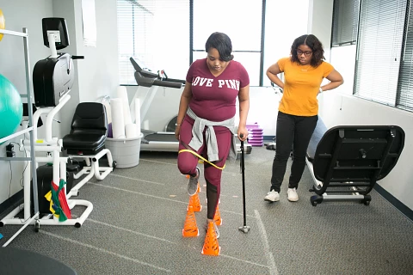
Core Values: Integrity
Steadfast adherence to high ethical principles or standards, being truthful, ensuring fairness, following through on commitments, and verbalizing to others the rationale for actions.

Slide 22
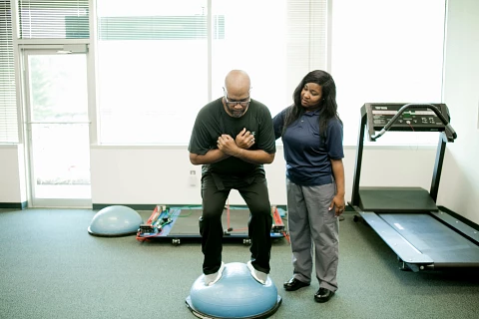
Core Values: Social Responsibility
The promotion of a mutual trust between the profession and the larger public that necessitates responding to societal needs for health and wellness.

Slide 23
Activity
What is an example of a physical therapist core value you have seen thus far in your education or career?
Notes:
You can divide learners in teams or groups for each core value and have them brainstorm living examples, then share the examples with the rest of the class.

Slide 24
Code of Ethics for the Physical Therapist
Delineates the ethical obligations of all physical therapists and defines the ethical principles that form the foundation of practice, consultation, education, research, and administration.
Notes:
Other resources: APTA Guide for Professional Conduct, Standards of Practice for Physical Therapy

Slide 25
Code of Ethics Purposes
Define the ethical principles that form the foundation of physical therapist practice in patient and client management, consultation, education, research, and administration.
Provide standards of behavior and performance that form the basis of professional accountability to the public.
Provide guidance for physical therapists facing ethical challenges, regardless of their professional roles and responsibilities.
Educate physical therapists, students, other health care professionals, regulators, and the public regarding the core values, ethical principles, and standards that guide the professional conduct of the physical therapist.
Establish the standards by which APTA can determine if a physical therapist has engaged in unethical conduct.

Slide 26

Code of Ethics for the Physical Therapist
Physical therapists shall provide:
  safe,
  accessible,
  cost-effective, and
  evidence-based services.
Notes:
Fundamental to the Code of Ethics is the special obligation of physical therapists to empower, educate, and enable those with impairments, activity limitations, participation restrictions, and disabilities to facilitate greater independence, health, wellness, and enhanced quality of life.

Slide 27
Standards of Practice for Physical Therapy
The Standards of Practice for Physical Therapy is the profession’s statement of conditions and performances that are essential for provision of high-quality professional service to society, and it provides a foundation for assessment of physical therapist practice expected across all settings.
Notes:
These documents identify criteria in the areas of ethical and legal considerations, administration of physical therapist services, and physical therapist practice, education, research, and community responsibility.

Slide 28
Educational Opportunities for PTs and PTAs
Physical Therapists
Physical Therapist Assistants
Fellowship
Residency
Board Certification
Advanced Proficiency Pathways
Notes:
Residency and fellowship programs provide post-professional education through one-to-one mentoring, structured curricular experiences, and guided learning designed to increase the quality of patient care and practitioner knowledge in specialty and subspeciality areas.
A residency program is a full- or part-time planned learning experience comprising a curriculum that encompasses the essential knowledge, skills, and responsibilities of an advanced physical therapist within a defined area of practice. When board certification exists through the American Board of Physical Therapist Specialties for that specialty, the residency program prepares the physical therapist with the requisite knowledge and skill set needed to pass the certification examination following graduation.
A fellowship is a full-or part-time planned learning experience comprising a curriculum that encompasses the essential knowledge, skills, and responsibilities of an advanced physical therapist within a defined area of subspecialty practice. A clinical fellowship candidate has either completed a residency program in a related specialty or is an ABPTS board-certified specialist in a related area of specialty.
Board certification in a clinical specialty is the process by which physical therapists build on a broad-based professional entry-level education and clinical practice experience and develop a greater depth of knowledge and skills related to a particular area of practice. It describes a specific area of patient need requiring unique advanced knowledge, skills, and abilities, terminating in board certification.
PTA Advanced Proficiency Pathways is the program for increasing a PTA’s knowledge and skill in a chosen area of physical therapy.

Slide 29
For expanded information regarding PT and PTA professional development opportunities, see Chapter 5.

Slide 30

Physical Therapist Roles Across the Continuum and Through the Life Span
Access to services for health conditions.
Direct access and primary care.
Administration of tests.
Habilitation and rehabilitation.
Performance enhancement.
Prevention and risk-reduction services.
Direct-to-employer physical therapist services.
Notes:
The continuum refers to a health care system’s ability to meet a person’s health needs and transitions at different levels of acuity and in different settings.
Physical therapists provide services as a point of entry into the health service delivery system through direct access (individual self-referral) practice models, and they also refer individuals to other health providers such as primary care physicians, neurologists, orthopedists, radiologists, and physical therapist specialists.
Physical therapists provide a unique perspective on purposeful, precise, and efficient movement across the life span based upon the synthesis of their distinctive knowledge of the movement system and expertise in mobility and locomotion. This expertise positions physical therapists to address major components of society’s primary care needs as providers who integrate in the evolving health care system.
Physical therapists administer tests such as imaging and nerve conduction velocities to aid in the diagnostic process.
Habilitation and rehabilitation address function, communication, participation, mobility, and engagement limitations that result from injury, disability, or other conditions.
Performance enhancement is the highest probable level of functioning that one may reach in her current environment.
Prevention involves practices and programs intended to reduce the frequency of a health condition in people with and without risk factors, to slow or stop the progression of a disease process, and to improve quality of life in a person with a disease process.
Direct-to-employer physical therapist services work directly with employers or employer groups to manage population health in addition to individual patients and clients.

Slide 31
Activity
Choose a diagnosis and describe the related roles and activities of the physical therapist.
Example: A patient comes in with an ACL rupture. Identify the roles a physical therapist could play and describe the activities in each role.
  Direct access
  Primary care
  Administration of tests
  Habilitation and rehabilitation
  Performance enhancement
  Prevention and risk-reduction
  Direct-to-employer services
Notes:
Another activity: Choose a PT role and describe patients who may access these services.

Slide 32

Professional Functions
Consultant
Educator
Researcher
Administrator/business owner and entrepreneur

Slide 33
Activity
Divide into small groups. For each professional role, identify job titles and settings that a PT and PTA might hold. Share in the larger group for a comprehensive review:
    Educator
    Researcher
    Consultant
    Administrator/business owner
    Entrepreneur

Slide 34
Chapter 2: Accessing Physical Therapist Services and the Elements of Patient and Client Management

Slide 35
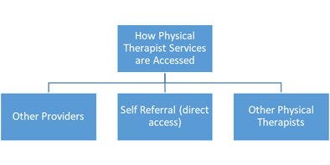
How Do Individuals Access Physical Therapist Services?
  Self-referral (sometimes termed “direct access”)
    State practice acts vary on allowances for self-referral/direct access
  Provider
    Other provider type
    Another physical therapist
    Intervention for a particular condition
Notes:
Self-referral (sometimes termed “direct access”).
Referral from another provider for:
A physical therapist examination (including tests and measurements),
Diagnosis of a particular condition,
Intervention for a particular condition.

Slide 36
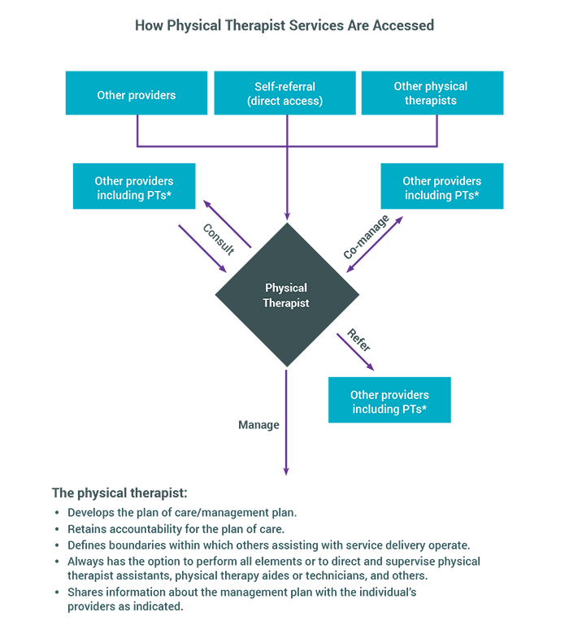
Decision Making
The physical therapist decides whether to provide interventions for the individual or refer them to another provider or multiple providers for management, co-management, or consultation.

Slide 37
The Physical Therapist May:
Co-manage: Collaborate with other professionals to direct or coordinate an individual’s management.
Consult: Render or receive professional expert opinion or advice concerning specialized knowledge and skills to identify problems, recommend solutions, or produce a specified outcome or product on behalf of an individual.
Manage: Manage and remain accountable for the services provided when the physical therapist's management plan involves the use of other recognized assistive personnel.
Refer: Refer an individual to another provider when the individual requires services that are outside of the PT’s personal, jurisdictional, or professional scope of practice. Similarly, the PT may choose to refer an individual for specific testing that the therapist deems necessary for the development of a working diagnosis or management plan.

Slide 38
Activity
Review each definition:
  Co-manage
  Consult
  Manage
  Refer
Describe patient conditions or presentations that would necessitate a PT perform each of the actions.

Slide 39
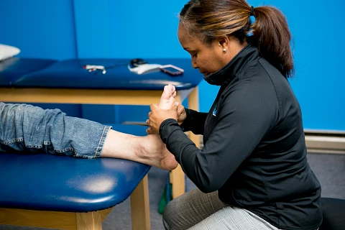
Episode of Care/Services
An episode of care/service consists of all physical therapist services that are:
  provided by a physical therapist,
  provided in an unbroken sequence, and
  related to management for a given condition or problem.
A visit consists of a physical therapist encounter or session.
Notes:
The episode of care/services may include transfers between sites within or across settings, or for multiple episodes of care/services for periodic follow-up over a lifetime to ensure optimal function and safety following changes in the individual’s physical status, caregivers, environment or task demands.

Slide 40
Consumers of Physical Therapist Services
Patients are individuals who receive physical therapist services for a disease, disorder, condition, impairment, activity limitation, or participation restriction.
Clients engage the services of a physical therapist and who can benefit from the physical therapist's consultation, interventions, professional advice, or health promotion, fitness, wellness, or prevention services. Clients may include businesses, school systems, and others to whom physical therapists provide services.

Slide 41
Consumers of Physical Therapist Services
Communities are groups of people that may or may not be spatially connected but who share common interests, concerns, or identities.
Populations are groups of people connected by their demographics and other factors; examples are ethnicity, socioeconomic status, and population density.

Slide 42
Activity: Group Discussion
How would your management plan/approach for a population differ from that of a patient?
How would it differ between a patient and a client?
How would your preparation and documentation for a patient differ from that of a client?
Which services would you envision to be beneficial for communities?
Notes:
Another activity – Michael is a 45-year-old man that works on an assembly line for an automaker. He stands for prolonged periods of time all throughout his workday and has developed plantar fasciitis. What might a physical therapist be able to do for this patient? What could a PT do for the company? For the community? What types of outcomes might be important for each group?

Slide 43
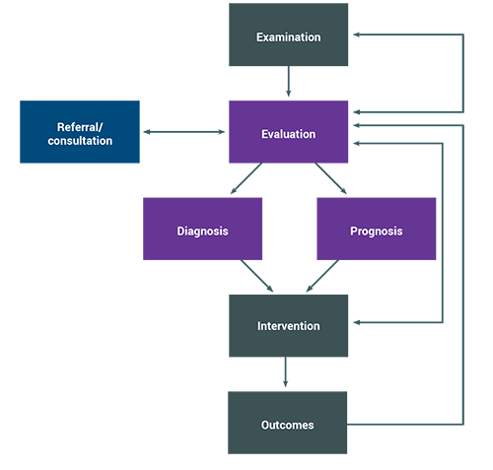
Patient and Client Management Model
Notes:
The physical therapist performs the examination and evaluation to gather and interpret the data necessary to determine if physical therapist services are appropriate or if a referral or consultation is indicated. When the examination and evaluation indicate the need for physical therapist services, the physical therapist establishes a diagnosis, prognosis, and management plan and identifies appropriate outcome measures.

Slide 44


Elements of Patient and Client Management
Examination
Evaluation
Diagnosis
Prognosis
Intervention
Outcomes
Referral/ consultation
Notes:
Examination: Collection of history, physical examination and tests and measures.
Referral/consultation: Physical therapist’s determination that an individual may require the services of another provider(s).
Evaluation: Interpretation and synthesis of findings.
Diagnosis: A label encompassing a cluster of signs and symptoms commonly associated with a disorder, syndrome or category of impairments.
Prognosis: Determination of the predicted optimal level of improvement over a designated time frame.
Intervention: Used to remediate impairments in all major body systems, improve functional performance, and promote improved health and wellness that lead to improved activity, participation, and quality of life.
Outcomes: Actual results of implementing the management plan that indicate the impact on function.

Slide 45
Activity
During the initial evaluation, the physical therapist has determined that the score collected on the Generalized Anxiety Disorder-7 screen (GAD-7) for the patient was 10/21, exceeding the screening threshold for risk of an anxiety disorder. Further evaluation and testing is recommended. What should the PT do?
Notes:
Should the PT refer out and cease the evaluation?
Can the PT continue to treat and manage the patient while further testing is done by another provider?

Slide 46
Activity Continued
During the history, the PT finds that the individual lives alone and has difficulty in buying food. This finding could impact the person’s well-being and the prognosis. What should the PT do?
Notes:
What risk is this describing? Should the PT continue to treat?

Slide 47
Chapter 3: Physical Therapist Examination and Evaluation

Slide 48

Examination
The physical therapist conducts an examination that includes:
  History.
  Physical examination.
  Tests and measures.
Notes:
History: Physical therapists use data from the history to build a preliminary hypothesis or hypotheses regarding the source of symptoms; and the existence and origin of impairments in body functions and structures, activity limitations, and participation restrictions. During the history, physical therapists also seek information relevant to major body systems through observation and questioning to help determine whether there are symptoms that suggest the need for referral for additional medical evaluation (Review of Systems).
The physical examination begins with the systems review, which should include:
Cardiovascular and pulmonary systems.
Integumentary system.
Musculoskeletal system.
Neuromuscular system.
Neurologic system.
Movement system.
Communication ability, affect, cognition, language, ability to read, and learning style.
The physical therapist uses measurements (including outcome measures) to identify impairments and potential causes of impairments in body structures and functions, activity limitations, and participation restrictions.

Slide 49
Reexamination
Reexamination includes the application of selected items from the history and physical examination and comparing them with the initial examination findings.
Reexamination may be indicated more than once during a single episode of care/services and often is performed over the course of a disease, disorder, or condition.
Notes:
Sample indications for reexamination include:
New or additional examination findings that may or may not be related to the primary diagnosis or reason for services.
Failure to respond to the overall management plan or to specific interventions applied during individual encounters.
Improvement in the presenting signs and symptoms that requires a change in the management plan to maximize the individual’s rehabilitation or outcome potential.
A change in the individual’s status.
A scheduled event such as an upcoming formal assessment or determination by other members of the management team, such as referring provider, for return to activity or participation clearance.

Slide 50
Activity
Compare the concepts of examination and reexamination.
Give an example of when a formal reexamination may be indicated.

Slide 51

Subjective History
Systematic gathering of subjective data obtained (through a comprehensive questioning process or completion of a patient self-administered questionnaire) from the individual and/or caregiver and other members of the health care team, and through a review of available health records.
Notes:
Why the individual is seeking services and additional data, including but not limited to:
Demographic information.
Social history.
Employment and work history.
Growth and development.
Living environment.
General health status.
Current and past health habits.
Social determinants of health.
Family history.
Medical and surgical history.
Current conditions or chief complaints.
Functional status and activity level.
Medications.
Previous level of function.
Specific goals.
And history of other diagnostic and clinically relevant testing.

Slide 52
Red Flags
Signs and symptoms found in the patient history and physical examination that suggest the presence of a serious pathology.
Example: Red Flags for Stroke (“Act F.A.S.T.”)
  Face: Smile and see if one side of the face droops.
  Arms: Raise both arms. Does one arm drop down?
  Speech: Say a short phrase and check for slurred or strange speech.
  Time: If the answer to any of these is yes, call 911 right away and write down the time when symptoms started.
Source: Centers for Disease Control and Prevention.

Slide 53
Activity
Provide a primary hypothesis that would require further, in-depth examination during a more detailed portion of the physical examination.
  A 78-year-old woman has a diagnosis of Parkinson disease and lives alone. Upon further questioning, you discover that she has challenges with communication (due to decreased respiratory function), cognitive decline (based on her son sitting with her during the appointment), limited physical activity, history of falls, and complaints of stiffness. A home health aide helps her with IADL, but she still has to cook and clean her home, which she says is difficult for her. She also notes several falls when attempting to cook in the kitchen for a long period of time, noting she has started bringing a chair to sit on for rest breaks.
Notes:
Possible answer: Collaborate with other colleagues: SLP (for communication); psychologist and/or OT (for cognitive decline and ADL assessment); social work (for supports, living arrangements). Requires a comprehensive management plan.
Primary hypothesis: Due to the expected progression of Parkinson disease, living arrangements, and fall risk, additional testing of vestibular testing, aerobic capacity, balance testing, and strength should be investigated. Progression of PD with limitations in respiratory function, balance, and household tasks, and participation restrictions requiring support services.

Slide 54
Review of Systems
Physical therapists seek information relevant to major body systems through observation and questioning to help determine whether there are symptoms that suggest the need for referral for additional medical evaluation.
  Cardiovascular system.
  Pulmonary system.
  Endocrine system.
  Eyes, ears, nose, and throat.
  Gastrointestinal system.
  Genitourinary/reproductive systems.
  Hematologic/lymphatic systems.
  Immune system.
  Integumentary system.
  Nervous system.
  Musculoskeletal system.
  Overall physical and psychological condition, such as unexplained weight change, fatigue, lethargy, and malaise; cognitive well-being; and emotional well-being, such as anxiety and feelings of hopelessness.
Notes:
Review of systems is the preliminary review of all the systems through observation, history, and questioning in order to determine if referral to another provider should occur prior to or in concert with PT management. It is an inventory of the body systems that is obtained through a series of questions in order to identify signs and/or symptoms which the patient may be experiencing.

Slide 55
Physical Examination
Begins with the systems review:
  Cardiovascular and pulmonary systems.
  Integumentary system.
  Musculoskeletal system.
  Neuromuscular system.
  Neurologic system.
  Communication ability, affect, cognition, language, ability to read, and learning style.
  Movement.
Notes:
The systems review is a brief or limited examination of (1) the anatomical and physiological status of the cardiovascular/pulmonary, integumentary, musculoskeletal, and neuromuscular systems and (2) the communication ability, affect, cognition, language, and learning style of the individual. The physical therapist especially notes how each of these last five components affects the ability to initiate, sustain, and modify purposeful movement for performance of an action, task, or activity that is pertinent to function. This is the beginning of the hands-on examination – it can include: inspection/observation (for example looking at a person’s gait or the way they stand up from a chair), palpation (for example pinpointing areas of tenderness), auscultation (listening to breath sounds), percussion (for example, checking reflexes with a reflex hammer), etc.

Slide 56
Activity
Explain the difference between the review of systems and the physical examination/systems review.
The PT sees in the history that the patient has smoked two packs per day for 10 years, so the PT auscultates the lungs and finds crackles in the right and left lower lobes. (Review of systems or physical exam/systems review?)
The patient self-referred to physical therapy for generalized joint pain and fear of falling. The PT scans the patient for joint deformities and asks questions about recent falls or loss of balance. (Review of systems or physical exam/systems review?)
Notes:
Review of systems: an inventory of the body systems that is obtained through a series of questions in order to identify signs and/or symptoms which the patient may be experiencing. During the history, physical therapists seek information relevant to major body systems through observation and questioning to help determine whether there are symptoms that suggest the need for referral for additional medical evaluation.
Physical examination/systems review: the physical therapist begins the “hands on” physical examination that includes the cardiovascular and pulmonary system, integumentary system, musculoskeletal system and neuromuscular system.
Example: The PT sees in the history that the patient has been a two-pack-per-day smoker for 10 years, so the PT auscultates the lungs and finds crackles in the right and left lower lobes. (Physical examination/systems review.)
Example: The patient self referred to PT for generalized joint pain and fear of falling. The PT scans the patient for joint deformities and asks questions about recent falls or loss of balance. (Review of systems.)

Slide 57
Tests and Measures
Physical therapists use measurements (including outcome measures):
  To identify impairments and potential causes of impairments in body structures and functions, activity limitations, and participation restrictions.
The results of tests and measures:
Inform risk identification and prevention and health promotion activities.
Contribute to outcome assessment.
Help the PT determine change in the individual’s status.
Notes:
The PT uses the results of the tests and measures for risk identification, and prevention and health promotion.
Tests help determine the outcome or change in the individual’s status during an episode of therapy, as well as changes in level of disability and/or goal attainment.

Slide 58
Tests and Measures
Tests and measures are a component of the physical examination used to:
  Confirm or reject a clinical hypothesis regarding the factors that contribute to making the individual’s current level of function less than optimal.
  Support the physical therapist’s clinical judgments about the diagnosis, prognosis, and development of an effective management plan.

Slide 59
26 Categories of Tests and Measures
Aerobic capacity/endurance.
Anthropometric characteristics.
Adaptive and assistive technology.
Balance.
Circulation (arterial, venous, lymphatic).
Cognitive and mental function.
Community, social, and civic life.
Cranial and peripheral nerve integrity.
Education life.
Environmental factors.
Gait.
Integumentary integrity.
Joint integrity and mobility.
Mobility (e.g., Locomotion).
Motor function.
Muscle performance (strength, power, endurance, and length).
Neuromotor development and sensory processing.
Pain.
Posture.
Range of motion.
Reflex integrity.
Self-care and domestic life.
Sensory integrity.
Skeletal integrity.
Ventilation and respiration.
Work/community integration.

Slide 60
Types of Measures
Performance-based measures involve observing the individual performing an activity.
Self-report measures provide information about the individual's perception of how their impaired body function or structure is limiting activities and participation.
Properties of Tests and Measures
Reliability: Consistent time after time, with as little variation as possible.
Validity: The degree to which a useful (meaningful) interpretation can be inferred from a measurement.

Slide 61
Measuring Outcomes
When standardized tests and measures are used to determine change in outcome status during and at the end of an episode of care, they may be referred to as outcome measures.
These tests may measure:
  • Functional status (activity limitations and participation restrictions), including changes in health, wellness, and fitness.
  • Impairments of body functions and structures.
  • Adverse outcomes and complications.
  • Morbidity and mortality.
  • The individual’s self-reported outcomes.
  • The individual’s satisfaction with the care/services received.

Slide 62
Activity
Review five tests and measures from APTA’s list of test and measure summaries and answer these questions for each:
  Where would the test be categorized (using the 26 categories of tests and measures)? Why?
  Is the test a performance-based measure or a self-reported measure? Why?
Notes:
What does the test measure?
What is the measure’s reliability?
What is the test’s validity?
What is the reported minimally important clinical difference, or MCID?

Slide 63
Evaluation
Evaluation is the interpretation and synthesis of the examination findings that lead to a diagnosis, prognosis, and management plan specific to the individual or community.
Physical therapists interpret and synthesize the history and the physical examination findings to:
  Establish a diagnosis from which to develop a management plan.
  Determine a prognosis, including goals for physical therapist management.
  Develop a management plan or plan of care if indicated.
  Develop a working diagnosis list as part of the process used to determine whether a referral to or consultation with another health care provider is indicated.

Slide 64
Activity
Give an example of a physical therapist examination and evaluation. What are the differences?
Describe a situation in which a red flag might come up and how you as the clinician will respond.

Slide 65
Chapter 4: Physical Therapist Practice: Diagnosis, Prognosis, Intervention, and Outcomes

Slide 66
Diagnosis
A label encompassing a cluster of signs and symptoms commonly associated with a disorder or syndrome or category of impairments in body structures and function, activity limitations, or participation restrictions.
Physical therapists establish a diagnosis in order to make appropriate management decisions for an individual and determine the most appropriate intervention strategy.

Slide 67
Diagnosis
Diagnosis Classifications:
ICD-10
ICF
Movement systems
Notes:
For payment, billing, and utilization management purposes physical therapists code diagnoses using ICD codes.
The ICF classifies functioning and disability associated with health conditions. ICF is the WHO framework for measuring health and disability at both individual and population levels.
The APTA House of Delegates position Management of the Movement System (HOD P06-15-25-24) states: "APTA endorses the development of diagnostic labels and/or classification systems that reflect and contribute to the physical therapists' ability to properly and effectively manage disorders of the movement system."
In 2017, the APTA Board of Directors endorsed the following criteria for use by any stakeholder group developing diagnostic classification systems or labels: Use recognized movement-related terms to describe the condition or syndrome of the movement system.
Include, if deemed necessary, the name of the pathology, disease, disorder, anatomical or physiological terms, and stage of recovery associated with the diagnosis.
Be as succinct and direct as possible to improve clinical usefulness.
Strive for movement system diagnoses that span all populations, health conditions, and the life span. Whenever possible, use similar movement-related terms to describe similar movements, regardless of pathology or other characteristics of the individual.

Slide 68

Prognosis
The physical therapist’s determination of the predicted optimal level of improvement in function over a designated time frame.
Prognosis typically includes a prediction of levels of improvement during the episode of physical therapy in determining goals and outcomes.
Can be influenced by contextual factors.

Slide 69
Activity
Read the Chapter 4 compendium and define a contextual factor. How can this influence a patient’s outcome or recovery?
What are some other resources a clinician might use to guide their prognosis?
Notes:
Alternative Activity: Emily is a 24-year-old woman who walks to work each day from her apartment in a large metropolitan area. She recently tore her Achilles playing in a recreational league volleyball match. Please provide a prognosis for Emily and describe the factors that affect this prognosis. Think of a possible contextual factor that would change your prognosis. Why and how would it change it?

Slide 70
Management Plan
A framework of physical therapist services provided to individuals, groups or populations, based on best available evidence, clinical expertise and the individual’s wants and needs.
May include a plan of care which consists of:
  Individual’s goals.
  Prognosis.
  Interventions to be used including duration and frequency.
  Summary of plans for referral or consultation to other providers.

Slide 71
Goals
The intended impact on functioning as a result of implementing the physical therapist management plan.
Measurable, functionally driven, time-limited, and, when applicable, classified as short term and long term.
Primary criterion for conclusion of physical therapist services is achievement of individual’s goals.

Slide 72
Goals
Example: Patient will ambulate for 100 feet with no assistive device using step-through gait pattern in three weeks in order to walk to mailbox each day.

Slide 73
Activity
Create a goal for a patient to be achieved in two weeks and a goal for a patient to achieve by the conclusion of physical therapist services.

Slide 74
Interventions
Physical therapists use interventions to remediate impairments in all major body systems, improve functional performance, and promote improved health and wellness that lead to optimized activity, participation, and quality of life.
Interventions are based on the PT’s examination findings, diagnosis, and the accompanying goals established as part of the management plan and plan of care.
Factors that influence complexity, frequency, and duration of the intervention and the decision-making process may include:
  Psychosocial and economic factors.
  Patient’s overall health status.
  Adherence to the intervention program.

Slide 75
Procedural Interventions
Adaptive and assistive technology
Biophysical agents
Functional training
Integumentary repair and protection techniques
Manual therapy
Motor function/movement training
Respiratory and ventilatory techniques
Therapeutic exercise
Notes:
Adaptive and assistive technology includes the prescription, application, and, as appropriate, fabrication or modification of splinting, bracing, taping, casting, seating and positioning technologies; aids for locomotion; orthotic devices; prosthetic devices; robotics; sensors; and other adaptive technologies to improve functioning.
Biophysical agents use various forms of energy and are intended to assist muscle force generation and contraction; decrease unwanted muscular activity; increase the rate of healing of open wounds and soft tissue; maintain strength after injury or surgery; modulate or decrease pain; reduce or eliminate edema; improve circulation; decrease inflammation; modify connective tissue extensibility and restriction associated with musculoskeletal injury or circulatory dysfunction; increase joint mobility; enhance muscle and neuromuscular performance; increase tissue perfusion and remodel scar tissue; and treat skin conditions.
Functional training is the education and training of individuals to improve their ability to perform physical actions, tasks, and activities in an efficient, typically expected, or competent manner.
Integumentary repair and protection involve the application of therapeutic methods and techniques to enhance wound perfusion and establish an optimal environment for wound healing.
Manual therapy is the synergistic application of movement-oriented strategies integrating exercise and manually applied mobilization and manipulation procedures.
Motor function/movement training is the performance of structured and sequenced training activities and motoric drills designed to develop and enhance task-specific voluntary movement.
Respiratory and ventilatory techniques are therapeutic activities intended to manage or prevent consequences of impaired gas exchange.
Therapeutic exercise is the systematic execution of planned physical movement or activities intended to enable individuals to remediate or prevent impairments of body functions and structures; modulate nociceptive, neuropathic, and nociplastic pain; enhance activities and participation; reduce risk factors; optimize overall health; and enhance fitness and well-being.

Slide 76
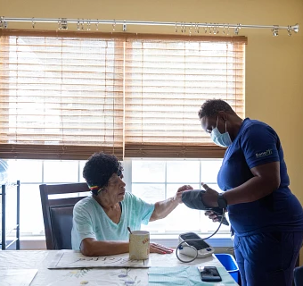
Physical Therapist Prevention Services
Primary prevention services by physical therapists is centered around a health and wellness program to reduce future injury or disease in an otherwise healthy population.

Slide 77
Activity
Think of an example of primary prevention services in physical therapist practice.

Slide 78
Outcomes
Outcomes are the actual results of implementing the management plan that indicate the impact on functioning.
Physical therapists report outcomes to demonstrate progress, for payment purposes, and to know whether goals have been met.

Slide 79
Activity
Identify the use of clinical outcomes that are measured and reported by physical therapists to describe the patient’s condition and progress.

Slide 80

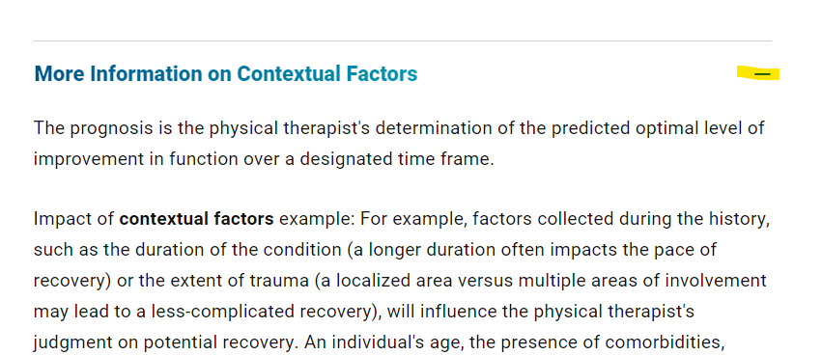
Using the Compendium
Enhance learning.
Dive deeper into a topic.
Access references.
To open or close the Compendium, click on the + or – sign.
Notes:
To open the Compendium information, click on the + sign. To close the Compendium information, click on the – sign.
The Compendium information includes more detailed information on a certain topic. It also includes all the references and links to the reference.

